Slide 1
Game 2
This game is to be played on completion of Lesson 20
Click to play

Slide 2
JEOPARDY!

Slide 3

How to play
Discuss ‘Question of the day’ before executing the game.
All questions should be read aloud by the student selecting the category.
If a player gives ‘incorrect answer’, then the other players go for ‘Battle of Buzzer’ and the question passes to the winner of the ‘Battle of Buzzer’.
If the player’s answer is correct, without delay/discussion move to the next question.
There are “Bonus Questions” inserted within some of the “Main Questions”:
  If the Bonus Question is on the same page as the Main Question, it should be answered/discussed before the main question.
  If the Bonus Question is on the answer page, it should be discussed after the Main Question is answered.
If there is any extra information given in the “Answer” page, this information should be read and discussed by the students.
Students should answer in full sentences. Answers that are not in full sentences will attract negative 50 points.
Click to play

Slide 4
Food
Music
General Knowledge
Sports
Brain Teasers
100
100
100
100
100
200
200
200
200
200
300
300
300
300
300
400
400
400
400
400
500
500
500
500
500

Slide 5
Food
Question for 100 points
What is the first meal of the day called ?
Show Answer

Slide 6
Food
Answer for 100 points
Breakfast

Slide 7
Food
Question for 200 points
What is the English name for ‘Rajma’ ?
Show Answer

Slide 8
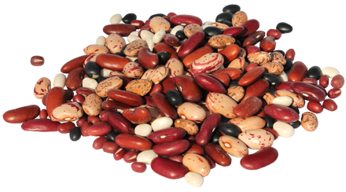
Food
Answer for 200 points
Kidney beans

Slide 9

Do’s and Don’ts of Jeopardy
Are your team members sitting on chairs while playing Jeopardy ?
If ‘No’ then award your team ‘100’ bonus points and if ‘Yes’ then deduct ‘100’ penalty points.
Show Question

Slide 10
Food
Question for 300 points
From the options below, which one is the name of a cuisine?
Dessert, Chinese, Kebabs,
Manchurian, Pizza
Show Answer
Bonus Question

Slide 11
Food
Bonus Question for 50 points
What is the meaning of ‘cuisine’?
Show Answer

Slide 12
Food
Bonus Answer for 50 points
The specific menu or manner of
preparing food which is typical of a place.
Main Question

Slide 13
Food
Answer for 300 points
Chinese

Slide 14
Food
Question for 400 points
Sometimes I am red in color and
sometimes I am green in color. I am sold as a vegetable but am a fruit.
Who am I ?
Show Answer

Slide 15
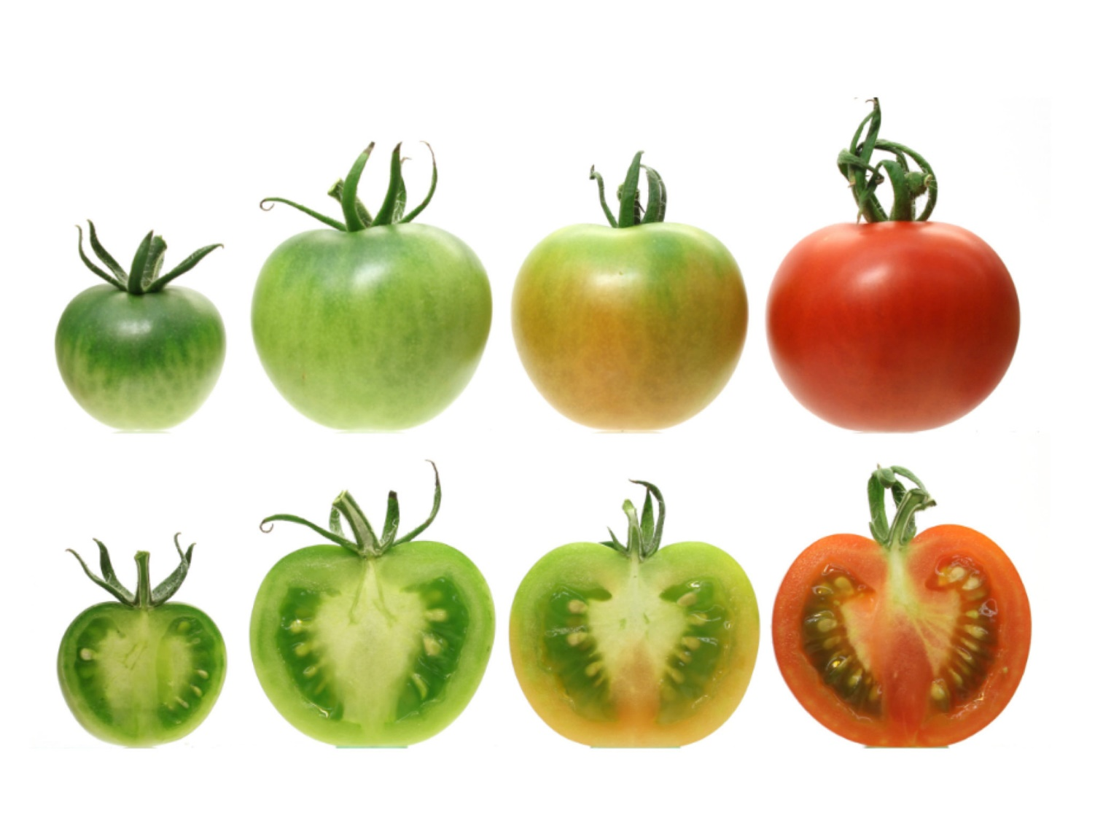
Food
Answer for 400 points
Tomato

Slide 16
Food
Question for 500 points
I am served at the end of a meal.
What am I ?
Show Answer

Slide 17
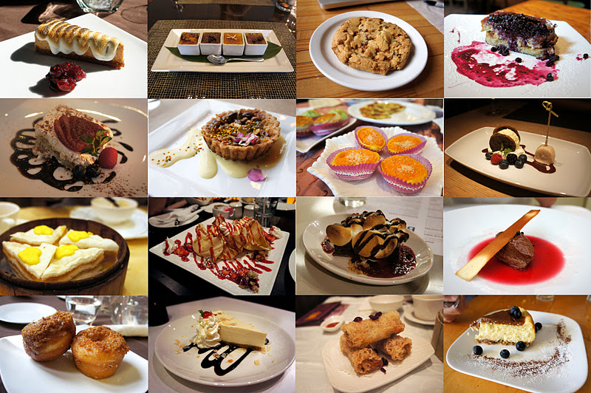
Food
Answer for 500 points
Dessert
(Sweet dish)

Slide 18
Do’s and Don’ts of Jeopardy
Are all teams using participation slips (Entry tickets) ?
If ‘Yes’ then award each team ‘100’ bonus points and if ‘No’ then deduct ‘100’ penalty points.
Show Question

Slide 19
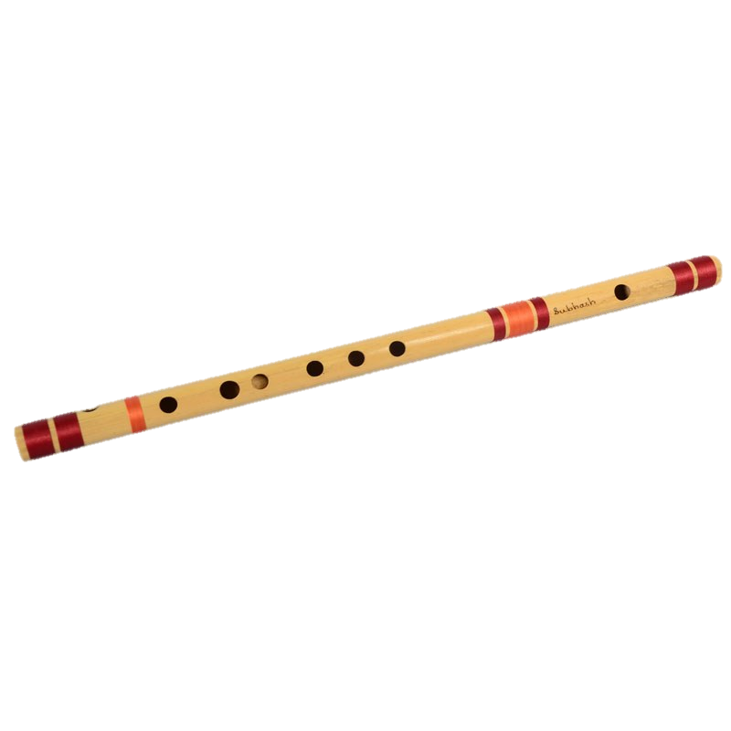
Music
Question for 100 points
Name the instrument in the picture.
Show Answer

Slide 20
Music
Answer for 100 points
Flute

Slide 21
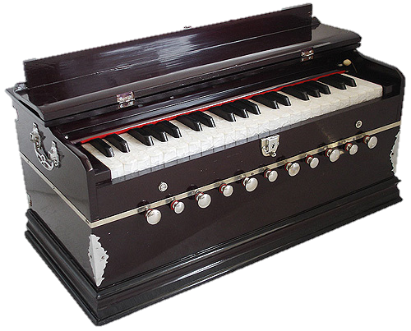
Music
Question for 200 points
Name the instrument in the picture.
Show Answer

Slide 22
Music
Answer for 200 points
Harmonium

Slide 23
Music
Question for 300 points
In Hindu mythology, the Goddess
of Knowledge, is shown holding
a musical instrument.
Name the instrument.
Show Answer

Slide 24
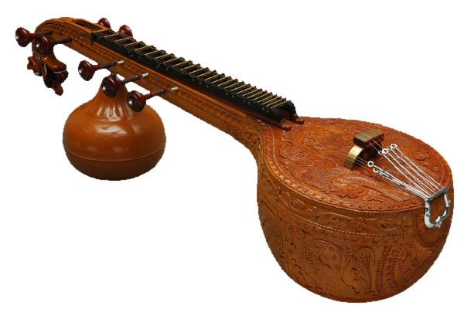
Music
Answer for 300 points
Veena

Slide 25
Music
Question for 400 points
For which song did A.R.Rehman
get an Oscar award?
Show Answer
Bonus Question

Slide 26
Music
Bonus Question for 50 points
What is the Oscar award ?
Show Answer

Slide 27
Music
Bonus Answer for 50 points
The Academy Awards or the Oscars are the highest international awards given in the USA for movies.
Main Question

Slide 28
Music
Answer for 400 points
“Jai ho !”
- Slumdog Millionaire

Slide 29
Music
Question for 500 points
Which musical instrument does
not belong in the group ? Why ?
Guitar, Sitar, Trumpet, Violin
Show Answer

Slide 30
Music
Answer for 500 points
Trumpet
Because, rest of the instruments are string instruments and trumpet is a wind instrument.

Slide 31
General Knowledge
Question for 100 points
Name the national fruit of India.
Show Answer

Slide 32
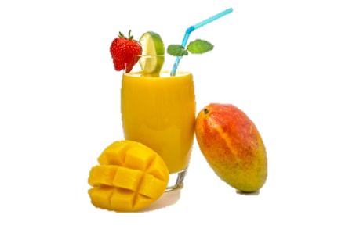
General Knowledge
Answer for 100 points
Mango

Slide 33
General Knowledge
Question for 200 points
How is the number 5 written in
Roman numerals?
Show Answer

Slide 34
General Knowledge
Answer for 200 points
V

Slide 35
Do’s and Don’ts of Jeopardy
Did any team select higher points questions while a lower points question was not played ?
Award each team with ‘No’ answer ‘100’ bonus points and deduct ‘100’ penalty points from each team with ‘Yes’ answer.
Show Question

Slide 36
General Knowledge
Question for 300 points
How many toes does a dog have?
Show Answer

Slide 37
General Knowledge
Answer for 300 points
18
Normally, a dog has four toes and two extra either on front or back,
which adds to a total of 18. Some dogs have 20 and a few also have 22.

Slide 38
General Knowledge
Question for 400 points
When is International Worker's Day
( also known as Labor Day) ?
Show Answer

Slide 39
General Knowledge
Answer for 400 points
1st of May

Slide 40
General Knowledge
Question for 500 points
When was Mahatma Gandhi
assassinated ?
Show Answer
Bonus Question

Slide 41
General Knowledge
Bonus Question for 50 points
What is ‘assassinated’ ?
Show Answer

Slide 42
General Knowledge
Bonus Answer for 50 points
Assassinated means to kill suddenly, especially a politically important person.
Main Question

Slide 43
General Knowledge
Answer for 500 points
January 30th, 1948

Slide 44
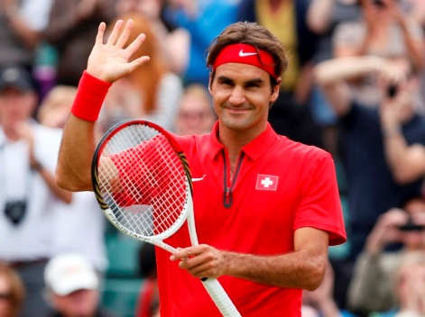
Sports
Question for 100 points
Name the player in the picture.
Show Answer

Slide 45
Sports
Answer for 100 points
Roger Federer

Slide 46
Sports
Question for 200 points
Which cricket legend retired from the game in November,2013 after his 200th
Test match at the age of 40 ?
Show Answer

Slide 47
Sports
Answer for 200 points
Sachin Tendulkar

Slide 48
Sports
Question for 300 points
Which player of Indian cricket
team was a ticket collector at
Kharakpur railway station ?
Show Answer

Slide 49
Sports
Answer for 300 points
M. S. Dhoni

Slide 50
Sports
Question for 400 points
Which sport does not
belong in the group below? Why?
Long Jump, Shot Put, Javelin, Discus Throw.
Show Answer

Slide 51
Sports
Answer for 400 points
Long Jump
In the other games we throw objects.

Slide 52
Sports
Question for 500 points
Which team did Germany
defeat to become World Cup
football champion of 2014?
Show Answer

Slide 53
Sports
Answer for 500 points
Argentina

Slide 54

Brain Teasers
Question for 100 points
Show Answer

Slide 55
Brain Teasers
Answer for 100 points
Article ‘The’ is repeated.

Slide 56
Brain Teasers
Question for 200 points
Do they have a 15th August
in England?
Show Answer

Slide 57
Brain Teasers
Answer for 200 points
Yes
It comes after the 14th of August.

Slide 58
Brain Teasers
Question for 300 points
If there are 3 apples and you take
away 2, how many do you have?
Show Answer

Slide 59
Brain Teasers
Answer for 300 points
Two
(Because you took away two)

Slide 60
Brain Teasers
Question for 400 points
A doctor gives you three pills telling
you to take one every half an hour.
How long would the pills last?
Show Answer

Slide 61
Brain Teasers
Answer for 400 points
One hour
Because you take one pill right now, one
after 30 minutes and last after an hour.

Slide 62
Brain Teasers
Question for 500 points
A woman gives a beggar Rs. 50 ; the
woman is the beggar's sister, but the
beggar is not the woman's brother.
How come?
Show Answer

Slide 63
Brain Teasers
Answer for 500 points
The beggar is woman's ‘Sister’.

